Slide 1
Maintaining State

Slide 2
Sharing Data Among Pages
Many times we want to be able to set some data on one Web page and then access it on another page.
  A user logs in at Login.aspx. In other pages on the website we want to know the login credentials for the user.
  When viewing a product the user adds it to his shopping cart. We need to know what item(s) are in the shopping cart when the user “checks out.”

Slide 3
State Maintenance Techniques
The Internet is stateless.
There’s no implicit “memory” between a client (Web browser) and server.
  When you make a request for the HTML content for a Web page, the web server doesn’t remember that you requested some other page 30 seconds ago.

Slide 4
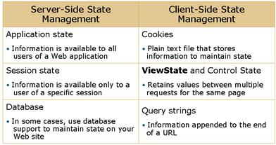
State Maintenance Techniques

Slide 5
Application State
Application state is stored in memory on the server.
Application state applies to all users and sessions.
Useful place to store small amounts of often-used data that does not change from one user to another.
Application state is stored in the HttpApplicationState class, a new instance of which is created the first time a user accesses any URL resource in an application.
The HttpApplicationState class is exposed through the Application property.
Application state stores data as Object data types. Therefore, you must convert the data back to the appropriate type when retrieving it.
[Additional Reading: For more information about saving application variables, see "How to: Save Values in Application State" at http://go.microsoft.com/fwlink/?LinkId=112477]

Slide 6
Session State
ASP.NET provides session state by using an instance of the HttpSessionState class for each active Web application session.
Session state is limited to the current browser session. If multiple users access a Web application, each user has a different session state.
Session state is structured as a key-value dictionary structure.
Each active Web application session is identified and tracked by using a 120-bit SessionID string that contains the ASCII characters that are allowed in URLs. Depending on how you configure the Web application settings, the SessionID strings are communicated across client-server requests either by means of an HTTP cookie or a modified URL
[Additional Reading: For more information about the HttpSessionState class, see "HttpSessionState Class" at http://go.microsoft.com/fwlink/?LinkId=112478]

Slide 7
Session State
Remembers data across all pages on a website on a user-by-user basis.
Stores the data on the web server in a session store.
Uses cookies to associate a particular visitor with a particular session store.
  Hence, only works for visitors whose browsers support cookies.
Great info about Session State at http://tinyurl.com/5nele ...

Slide 8
Tracking Session ID
Using cookies
  The session ID is transmitted in a special cookie (named ASP.NET_SessionId)
Cookieless (using modified URLs)
  the session ID is transmitted in a specially modified (or “munged”) URL.

Slide 9

Session Variables
Think of session state as a set of variables stored on the Web server. These variables are tied to a specific user. So, if N users visit the Web site, there will be N set of session variables residing on the Web server.
Each user is tied to a set of session variables
Session 1
Web
Server
Session 2
Session 3

Slide 10
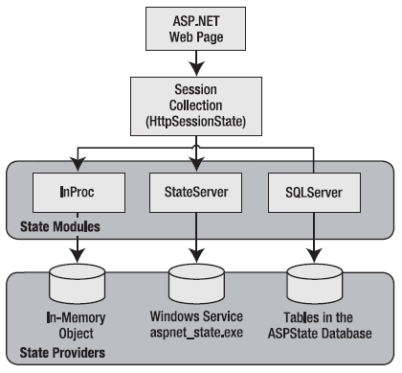
Session Architecture
ASP.NET session state architecture

Slide 11
ASP.NET makes it easy to maintain session state.
ASP.NET exposes an object called Session, which is a collection of objects indexed by a string key.
ASP.NET will automatically maintain the session variables for you and correctly associate them with each unique user automatically.
Session(key) = value
DEMO3: Session1.aspx

Slide 12
Using Session State
For example, you might store a DataSet in session memory like this:
  Session("ProductsDataSet") = dsProducts
You can then retrieve it with an appropriate conversion operation:
  dsProducts = DirectCast(Session("ProductsDataSet"), DataSet)

Slide 13
Loosing Session State
Session state can be lost in several ways:
  closing and restarting the browser.
  accessing the same page through a different browser window, although the
  session times out because of inactivity. By default, a session times out after 20 idle minutes.
  calling Session.Abandon().

Slide 14
Session Variables
Issues:
  Performance / Memory Consumption – since session variables are maintained on the webserver if you have a lot of concurrent visitors and you store large amounts of data in session, can impact the website’s performance.
  Expiring Session Variables – how do we know when a user’s session ends? What if they just close their browser? There’s no way to know that they’ve left. Session variables have a timeout (defaults to 20 minutes). If no activity arrives in 20 minutes, user’s session is assumed to be expired, and the session store for that user is deleted.

Slide 15
Session Variables
Session variables are an easy way to share data among multiple web pages in a website.
Do not overuse session variables.
  Not guaranteed to be supported by your visitors.
  Timeout issues can lead to an undesirable user experience, including loss of “important” state (shopping cart data, for example).

Slide 16
Configuring Session State
configure session state through the <sessionState> element in the web.config file
<?xml version="1.0" encoding="utf-8" ?>
<configuration>
<system.web>
<!-- Other settings omitted. -->
<sessionState
mode="Off|InProc|StateServer|SQLServer|Custom"
stateConnectionString="tcpip=127.0.0.1:42424"
stateNetworkTimeout="10"
sqlConnectionString="data source=127.0.0.1;Integrated Security=SSPI"
sqlCommandTimeout="30" allowCustomSqlDatabase="false“
useHostingIdentity="true|false"
compressionEnabled="true|false"
cookieless="UseCookies" cookieName="ASP.NET_SessionId"
regenerateExpiredSessionId="true|false"
timeout="20"
customProvider=""
/>
</system.web>
</configuration>

Slide 17
Mode
Off
disables session state management for every page in the application
InProc
Is the default option
Won’t work in a web farm scenario

Slide 18
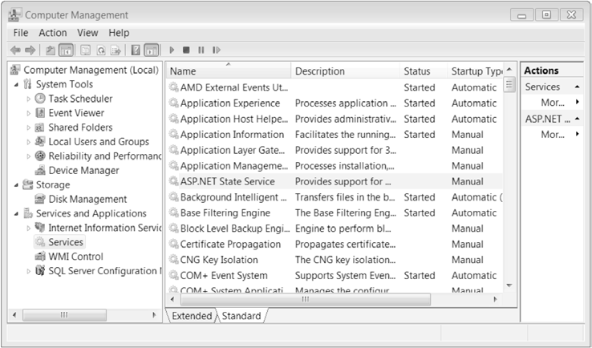
Mode
SateServer
need to specify a value for the stateConnectionString setting.
TCP/IP address of the computer that is running the StateServer service and its port number
ASP.NET state server service

Slide 19
Mode
SQL server
uses a SQL Server database to store session information
need to install the special stored procedures and temporary session databases
To use aspnet_regsql.exe to create a session storage database, supply the -ssadd parameter, the -S parameter to indicate the database server name, and the -E parameter to log in to the database using the currently logged in Windows user account
Example
  aspnet_regsql.exe -S localhost -E –ssadd
modifying the <sessionState> section of the web.config file
  <sessionState mode="SQLServer" sqlConnectionString="data source=localhost;Integrated Security=SSPI" ... />

Slide 20
aspnet_regsql.exe
to use aspnet_regsql.exe to create the state tables in a different database (not ASPState)
aspnet_regsql.exe -S localhost -E -ssadd -sstype c -d MyCustomStateDb
make two configuration tweaks to the <sessionState> element in your application’s web.config file
<sessionState Mode="SQLServer" allowCustomSqlDatabase="true" sqlConnectionString=
"data source=localhost;Integrated Security=SSPI;Initial Catalog=MyCustomStateDb"
... />

Slide 21
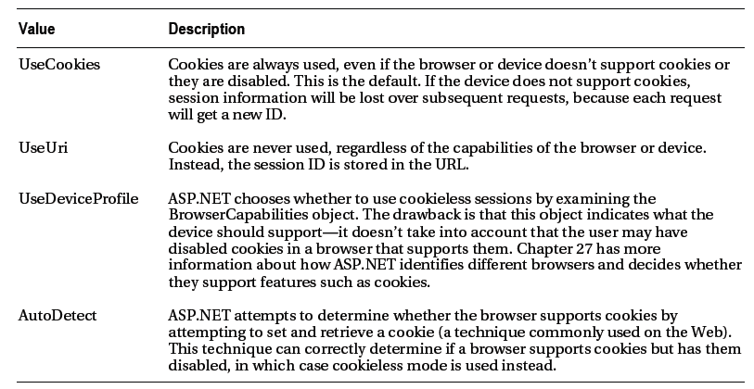
Cookieless
set the cookieless setting to one of the values defined by the HttpCookieMode enumeration
HttpCookieMode value

Slide 22
Cookieless
Example
<sessionState cookieless="UseUri" ... />
the session ID will automatically be inserted into the URL.
Example of a munged URL:
  http://localhost/WebApplication/(amfvyc55evojk455cffbq355)/Page1.aspx

Slide 23
Cookieless
relative links also automatically gain the
session ID
  Response.Redirect("Page2.aspx")
absolute links will not contain the session ID
  Response.Redirect("http://localhost/WebApplication/Page2.aspx")

Slide 24
Timeout
To specify the number of minutes that ASP.NET will wait, without receiving a request, before it abandons the session
  <sessionState timeout="20" ... />

Slide 25
The Global.asax File
Only one Global.asax file per Web application
Stored in the virtual root of the Web application
Used to handle application and session events
The Global.asax file is optional

Slide 26
Global events handled in the global.asax.vb file
Application_Start
  This event is fired when the application is started. The application starts when the first request comes to the web server after the IIS is started.
  The Application start event can occur if the IIS is restarted, server rebooted, web.config file is changed or if the ASP.NET process recycles.
  ASP.NET process recycles for various reasons like insufficient memory, server overload, other un expected errors etc.
  This is the first event fired in ASP.NET after the application starts.
Application_End
  Application_End event is fired when the application ends like shutting down server, re starting IIS, recycling ASP.NET process etc.
  Note that, if somebody power off the server, server will not get a chance to fire the events and this event will never be fired.

Slide 27
Global events handled in the global.asax.vb file
Session_Start
  Session_Start event is fired each time a new session is started.
Session_End
  This event is fired when the session expires. Note that even if the user close the browser and leave, this event will not be fired immediately. Only after the session times out, the server will know that the user is no longer accessing the site and this event will be fired.
  Session_End event will be fired if the application restarts.

Slide 28
Initializing Application and Session Variables
Variables are initialized in Global.asax
  The Application object shares information among all users of a Web application
    Sub Application_Start(ByVal Sender As Object, ByVal e As EventArgs)
    Application(“Visits") = 0
    End Sub
  The Session object stores information for a particular session
    Sub Session_Start(ByVal Sender As Object, ByVal e As EventArgs)
    Session("BackColor") = "beige"
    Session("ForeColor") = "black"
    End Sub

Slide 29
Setting Session and Application Variables
To set the session variable, you must provide a key that identifies the item that you want to store.
  Eg. Session("BackColor") = "blue“
Whenever Application data is updated, you must prevent other users or applications from updating the data simultaneously by using Application.Lock() and Application.UnLock()

Slide 30
Updating application state data simultaneously
For example, if two clients requested the page at the same time, you could have a sequence of events like this:
  User A retrieves the current count (432).
  User B retrieves the current count (432).
  User A sets the current count to 433.
  User B sets the current count to 433.

Slide 31
Using Application.Lock()
Application.Lock()
Application("Visits") = CInt(Application("Visits")) + 1
Application.UnLock()

Slide 32
Reading Session and Application Variables
Read the value from the Session or Application object.
lblVisits.ForeColor = colconvert.ConvertFromString(Session("ForeColor"))
lblVisits.BackColor = colconvert.ConvertFromString(Session("BackColor"))
lblVisits.Text = "This page has been visited " & _
CStr(Application("Visits")) & " times."

Slide 33
Application and Session Variable Duration
Session variables have a set duration after last access:
Default is 20 minutes
Session duration can be changed in web.config
    <configuration>
    <system.web>
    <sessionState timeout="10" />
    </system.web>
    </configuration>
Application variable persist until the Application_End event is fired.

Slide 34
Cookies
Stored either in a text file on the file system of the client computer or in-memory in the client-browser session.
The two types of cookies:
  Persistent cookies
    With a definite expiration period.
  Temporary / non-persistent cookies
    Any temporary cookies that are added to the browser are lost when the browser is shut down.
Cookies are subject to tempering and could cause the application that is dependent on the cookie to fail.
Each individual cookie can contain no more than 4 KB of information.

Slide 35
Creating a Cookie
Dim myCookie As New HttpCookie("CookieName")
myCookie.Values.Add("ForeColor", "White")
myCookie.Expires = now.AddHours(1)
Response.Cookies.Add(myCookie)
Add a pair of key and value
To create a persistent cookie, specify the expiration time

Slide 36
Retrieving Information from a Cookie
Read the cookie
Dim getCookie As HttpCookie = Request.Cookies("CookieName")
Retrieve values from the cookie
lblMessage.Text = lblMessage.Text & getCookie.Values("ForeColor")
lblMessage.ForeColor = System.Drawing.Color.FromName(getCookie.Values("ForeColor"))

Slide 37
View State
Use the built-in page property called ViewState to add data to the view state collection
Example, ViewState("Counter") = 1 places the value 1 into the ViewState collection and gives it the descriptive name Counter
Use the key name to retrieve a value and cast the retrieved value to the appropriate data type

Slide 38
View State Example
Example
Dim Counter As Integer
If ViewState("Counter") IsNot Nothing Then _
Counter = Int(ViewState("Counter"))

Slide 39
NullReferenceException
Looking up a value that isn’t present in the collection will return a NullReferenceException
Check for a null value before attempting to retrieve and cast data

Slide 40
Storing Objects in View State
to store an item in view state, ASP.NET must be able to convert it into a stream of bytes so that it can be added to the hidden input field in the page; a process called serialization
add the Serializable attribute before your class declaration.

Slide 41
Storing Objects in View State
<Serializable()>
Public Class Customer
Public m_FirstName As String
Public m_LastName As String
Public Sub New(ByVal firstName As String, ByVal lastName As String)
m_FirstName = firstName
m_LastName = lastName
End Sub
End Class

Slide 42
Store a customer in view state.
Dim cust As Customer = New Customer("George", "oftheJungle")
ViewState("CurrentCustomer") = cust

Slide 43
Cast the data when retrieving it from view state
' Retrieve a customer from view state.
Dim cust As Customer
cust = DirectCast(ViewState("CurrentCustomer"), Customer)
Requirements for classes to be serializable
  Must have the Serializable attribute
  Any classes it derives from must have the Serializable attribute
  All the member variables of the class must use serializable data types. Any nonserializable data type must be decorated with the NonSerialized attribute (which means it is simply ignored during the serialization process).

Slide 44
Disabling View State
set the EnableViewState property of the control to false
set the EnableViewState property of the page to false
<%@ Page Language="VB" EnableViewState="false" ... %>
setting the enableViewState attribute of the <pages> element in the web.config file
<configuration>
<system.web>
<pages enableViewState="false" />
...
</system.web>
</configuration>

Slide 45
ViewStateMode
To explicitly enabling view state for a particular control when view state for the page is disabled by setting the ViewStateMode.
ViewStateMode takes one of three values
  Enabled
  Disabled
  Inherit

Slide 46
View State Security
View state information is stored in a single Base64-encoded string
<input type="hidden" name="__VIEWSTATE"
id="__VIEWSTATE" value="dDw3NDg2NTI5MDg7Oz4="/>
Two choices to make view state secure
  make sure that the view state information is tamper-proof by using a hash code (Hash codes are enabled by default)
  To disable hash code,
    For a single page,
  <%@ Page EnableViewStateMac="false" ... %>
    For all pages,
  <configuration>
  <system.web>
  <pages enableViewStateMac="false" />
  ...
  </system.web>
  </configuration>

Slide 47
View State Security
  enable view state encryption
For a single page,
<%@Page ViewStateEncryptionMode="Always" ... %>
For all pages,
<pages viewStateEncryptionMode="Always" />

Slide 48
QueryString Parameters
Can direct a user to a web page, passing along the information to share through querystring parameters.
QueryString parameters are extra bits of information in the URL:
  http://anything/Page.aspx?Name1=Value1&Name2=Value2&...&NameN=ValueN
The querystring (which is optional) is appended to the URL with a ?

Slide 49
QueryString Parameters
Each querystring parameter is delimited from one another with an ampersand (&).
Each querystring parameter is a name/value pair. It has a name that identifies the parameter, and a value that represents the querystring parameter’s value.
  The name and value are delimited by an equals sign (=)

Slide 50
QueryString Parameters
Can programmatically access the value for a particular querystring parameter using the following code:
Dim qsValue as String = _
Request.QueryString(“Name1")

Slide 51
Can send a user to another page:
  Through <a> tags
  Programmatically, via Response.Redirect(url)
// Assume there is some TextBox Web control
// txtName, that the user has entered their
// name into… we want to pass this to
// SomePage.aspx
Response.Redirect("SomePage.aspx?Name=" +
txtName.Text);
Demo1: QueryString1.aspx

Slide 52
URL Encoding
special characters are replaced by escaped character sequences starting with the percent sign (%), followed by a two-digit hexadecimal representation
the space character can be represented as the character sequence %20 or the + sign.

Slide 53
Server.UrlEncode() and HttpServerUtility.UrlDecode()
To encode a string of arbitrary data for use in the query string
  Dim productName As String = "Flying Carpet"
  Response.Redirect("newpage.aspx?productName=" & Server.UrlEncode(productName))
use the HttpServerUtility.UrlDecode() method to return a URL-encoded string to its initial value.
ASP.NET automatically decodes your values when you access them through the Request.QueryString collection

Slide 54
Cross-Page Posting
Rich UI controls that submit forms (i.e., controls that implement the IButtonControl interface
and include Button and LinkButton) support cross-page posting, where the PostBackUrl attribute is used to specify
where the form data should be posted

Slide 55
CrossPageSource.aspx
<div>Enter your name:
<asp:TextBox ID="nameValue" runat="server"></asp:TextBox></div>
<asp:Button ID="Button1" Text="Cross-Page Postback" PostBackUrl="CrossPageTarget.aspx" runat="server" />
&nbsp;<asp:Button ID="btnManualTransfer" runat="server" Text="Using Server.Transfer" />

Slide 56
CrossPageSource.aspx.vb
Partial Class CrossPageSource
Inherits System.Web.UI.Page
Public ReadOnly Property Name() As String
Get
Return nameValue.Text
End Get
End Property
Protected Sub btnManualTransfer_Click(sender As Object, e As EventArgs) Handles btnManualTransfer.Click
Server.Transfer("CrossPageTarget.aspx")
End Sub
End Class

Slide 57
CrossPageTarget.aspx
<%@ Page Language="VB" AutoEventWireup="false" CodeFile="CrossPageTarget.aspx.vb" Inherits="CrossPageTarget" %>
<%@ PreviousPageType VirtualPath="CrossPageSource.aspx" %>
<!DOCTYPE html>
<html xmlns="http://www.w3.org/1999/xhtml">
<head id="Head1" runat="server">
<title></title>
</head>
<body>
<form id="form1" runat="server">
<div>
Your name is: <asp:Label ID="lbl" runat="server" Text="Label"></asp:Label>
</div>
<asp:Button ID="Button1" Text="Back" PostBackUrl="CrossPageSource.aspx" runat="server" />
</form>
</body>
</html

Slide 58
CrossPageTarget.aspx.vb
Partial Class CrossPageTarget
Inherits System.Web.UI.Page
Protected Sub Page_Load(sender As Object, e As EventArgs) Handles Me.Load
If PreviousPage IsNot Nothing Then
If Not PreviousPage.IsValid Then
Response.Redirect(Request.UrlReferrer.AbsolutePath & "?err=true")
Else
lbl.Text = "You came from a page titled " & _
PreviousPage.Header.Title & "<br />"
Dim prevPage As CrossPageSource = _
TryCast(PreviousPage, CrossPageSource)

Slide 59
CrossPageTarget.aspx.vb
If prevPage IsNot Nothing Then
lbl.Text &= "You typed in this: " & _
prevPage.Name & "<br />"
End If
If PreviousPage.IsCrossPagePostBack Then
lbl.Text &= "The page was posted directly"
Else
lbl.Text &= "You used Server.Transfer()"
End If
End If
End If
End Sub
End Class

Slide 60
defined a Public property called Name that returns the Value property from the server-side input element we defined in the Web Form

Slide 61
The PreviousPageType directive, which allows us to specify the Web Form that the cross-page post will originate from. This allows us to access the properties and methods of the originating Web Form’s code-behind class via the PreviousPage property, which is defined by the Page class.

Slide 62
use the PreviousPage property in the code nugget to get the value of the Name property

